Slide 1
Basic Tokenizing, Indexing, and Implementation of Vector-Space Retrieval: Simple tokenizing
14-02-2023

Slide 2
Tokenization
Tokenization, including how to handle Out-of-Vocabulary words (OOV)

Slide 3
Token
A token is an instance of a sequence of characters in some particular document that are grouped together as a useful semantic unit for processing
A type is the class of all tokens containing the same character sequence. A term is a (perhaps normalized) type that is included in the IR system's dictionary

Slide 4
Simple Tokenization
Analyze text into a sequence of discrete tokens (words).
Sometimes punctuation (e-mail), numbers (1999), and case (Republican vs. republican) can be a meaningful part of a token.
However, usually they are not.
Simplest approach is to ignore all numbers and punctuation and use only case-insensitive unbroken strings of alphabetic characters as tokens.

Slide 5
Tokenization in HTML
• Should text in HTML commands not typically seen by the user be included as tokens?
Words appearing in URLs.
Words appearing in “meta text” of images.
• Simplest approach used in VSR is to exclude all HTML tag information from tokenization.
Parses HTML using utilities in Java Swing package, and collects all raw text
NOTE: vector-space retrieval (VSR)

Slide 6
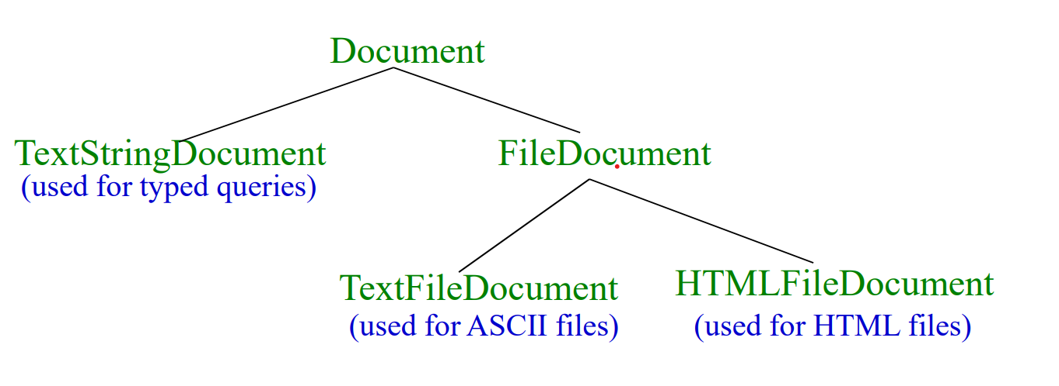
Documents in VSR

Slide 7
Stopwords
It is typical to exclude high-frequency words (e.g. function words: “a”, “the”, “in”, “to”; pronouns: “I”, “he”, “she”, “it”).
Stopwords are language dependent. VSR uses a standard set of about 500 for English.
For efficiency, store strings for stopwords in a hashtable to recognize them in constant time.
7

Slide 8
Stemming
Reduce tokens to “root” form of words to recognize morphological variation.
– “computer”, “computational”, “computation” all reduced to same token “compute”
Correct morphological analysis is language specific and can be complex.
Stemming “blindly” strips off known affixes (prefixes and suffixes) in an iterative fashion.
8

Slide 9
Porter Stemmer
Simple procedure for removing known affixes in English without using a dictionary.
Can produce unusual stems that are not English words:
– “computer”, “computational”, “computation” all reduced to same token “comput”
May conflate (reduce to the same token) words that are actually distinct.
Not recognize all morphological derivations.
9

Slide 10
Porter Stemmer Errors
Errors of “comission”:
organization, organ  organ
police, policy  polic
arm, army  arm
Errors of “omission”:
cylinder, cylindrical
create, creation
Europe, European
10

Slide 11
Sparse Vectors
Vocabulary and therefore dimensionality of vectors can be very large, ~10⁴ .
However, most documents and queries do not contain most words, so vectors are sparse (i.e. most entries are 0).
Need efficient methods for storing and computing with sparse vectors.
10

Slide 12
Sparse Vectors as Lists
Store vectors as linked lists of non-zero- weight tokens paired with a weight.
Space proportional to number of unique tokens
(n) in document.
Requires linear search of the list to find (or change) the weight of a specific token.
Requires quadratic time in worst case to compute vector for a document:
n

i =1
i = ^{n(n + 1)} = O(n ² )
2
11

Slide 13
Sparse Vectors as Trees
Index tokens in a document in a balanced binary tree or trie with weights stored with tokens at the leaves.
memory
< 
film variable
Balanced Binary Tree
< 
bit film memory variable 2 1 1 2
<


Slide 14
Sparse Vectors as Trees (cont.)
Space overhead for tree structure: ~2n nodes.
O(log n) time to find or update weight of a specific token.
O(n log n) time to construct vector.
Need software package to support such data structures.

Slide 15
Sparse Vectors as HashTables
Store tokens in hashtable, with token string as key and weight as value.
Storage overhead for hashtable ~1.5n.
Table must fit in main memory.
Constant time to find or update weight of a specific token (ignoring collisions).
O(n) time to construct vector (ignoring collisions).

Slide 16
Sparse Vectors in VSR
Uses the hashtable approach called a HashMapVector.
The hashMapVector() method of a Document computes and returns a HashMapVector for the document.
hashMapVector() only works once after initial Document creation (i.e. Document object does not store it internally for later reuse).

